Slide 1
Backtracking Algorithm Implementation for Sudoku Solver
Jonathan Dervin, Roman Higginson, Zaryaab Qasmi

Slide 2
Abstract

Slide 3
Introduction

Slide 4
Background
Sudoku
A puzzle game that involves the player entering certain numbers from 1 to 9 into a 9x9 grid while being mindful of not violating the rules of the game.
When a player inputs a number, the number must not be the same as another number in the same row, the same column, and the same 3x3 sub-grid.
Solving Strategy Examples
Hidden Singles
Naked Pairs/Triples
Hidden Pairs/Triples.

Slide 5
Problem Statement
The backtracking algorithm addresses are the rules that this game abides by. The fact that each number in each row, column, and sub-grid must be unique.

Slide 6
Objective
The goal was to use several solving strategies to solving 5 boards. But when none of the solving strategies can be used, the program will resort to using the backtracking algorithm to solve them.

Slide 7
Methodology

Slide 8
Algorithm Overview
A Sudoku Board is considered to be a Constraint Satisfaction Problem (CSP):
A problem where we need to assign a set of variables that satisfy all of the restrictions given. The backtracking algorithm is a searching algorithm for CSPs where we use a search tree to assign a single variable per level.
Key Components of a CSP:
Variables: These represent every cell inside the Sudoku board
Domains: These represent a list of numbers that each cell can have.
Constraints: These represent the limitations each value in the cell must follow.
The backtracking algorithm is meant to assign a number from a domain to an empty cell while being consistent to the constraints of the Sudoku board. If the cell is not consistent, unassign the cell and go to the next number in the domain. If the cell is consistent, go to the next empty cell. If no number in the cell’s domain is consistent to the constraint, backtrack to the last cell that was assigned.

Slide 9
Algorithm Overview
Backtracking Algorithm Logic
Assign a number from a domain to an empty cell while being consistent to the constraints of the Sudoku board.
If the cell is not consistent, unassign the cell and go to the next number in the domain. If the cell is consistent, go to the next empty cell.
If no number in the cell’s domain is consistent to the constraint, backtrack to the last cell that was assigned.

Slide 10
Implementation Details

Slide 11
Results

Slide 12
Performance Analysis
It solved all five puzzles using the backtracking algorithm.
Each puzzle was tested 5 times to calculate the average time each one took to solve.

Slide 13
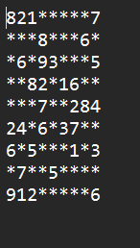
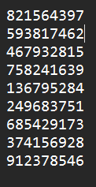
Puzzle 1
Number of Backtracks: 1516
Times
Run 1: 44.6 ms
Run 2: 60.5 ms
Run 3: 49.2 ms
Run 4: 47.2 ms
Run 5: 45.8 ms
Average Time: 49.5 ms
Difficulty:

Slide 14
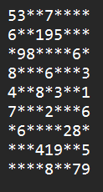
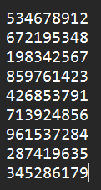
Puzzle 2
Number of Backtracks: 4209
Times
Run 1: 112 ms
Run 2: 116 ms
Run 3: 109 ms
Run 4: 115 ms
Run 5: 116 ms
Average Time: 113.6 ms
Difficulty:

Slide 15
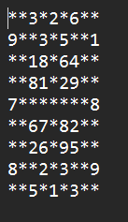
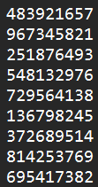
Puzzle 3
Number of Backtracks: 201
Times
Run 1: 15.1 ms
Run 2: 13 ms
Run 3: 11.8 ms
Run 4: 11.3 ms
Run 5: 12.6 ms
Average Time: 12.8 ms
Difficulty:

Slide 16
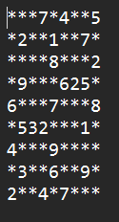
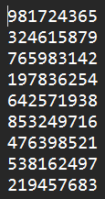
Puzzle 4
Number of Backtracks: 70373
Times
Run 1: 1.79 s
Run 2: 1.79 s
Run 3: 1.8 s
Run 4: 1.81 s
Run 5: 1.8 s
Average Time: 1.8 s
Difficulty:

Slide 17
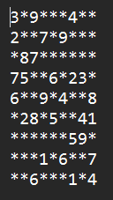
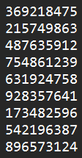
Puzzle 5
Number of Backtracks: 1525
Times
Run 1: 44 ms
Run 2: 42.8 ms
Run 3: 43 ms
Run 4: 42.7 ms
Run 5: 46.1 ms
Average Time: 43.7 ms
Difficulty:

Slide 18
Discussion

Slide 19
Efficiency Evaluation
Time Complexity:
O(k^{n})
Space Complexity:
O(k^{n})
k being how many times the function recursively calls itself and n being the number of empty cells on the board.

Slide 20
Limitations

Slide 21
Conclusion

Slide 22
Summary of Findings

Slide 23
Recommendations

Slide 24
References
Backtracking. Interviews.school. (n.d.). https://interviews.school/backtracking
GeeksforGeeks. (2023, October 16). Introduction to backtracking - data structure and algorithm tutorials. https://www.geeksforgeeks.org/introduction-to-backtracking-data-structure-and-algorithm-tutorials/
Gupta, U. (2024, March 26). Recursion & Backtracking Time Complexity. Code 360 by coding ninjas. https://www.naukri.com/code360/library/recursion-backtracking-time-complexity
Stuart, A. (2005, May 28). Sudoku solver by Andrew Stuart. https://www.sudokuwiki.org/sudoku.htm

